Slide 1
ABC Store Data Analysis

Slide 2
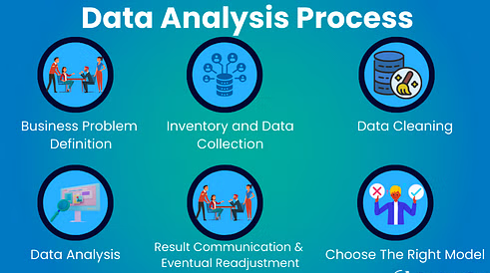
Data Analysis
Data analysis inspects, cleans, transforms, and models' data to extract insights and support decision-making. Data analysis plays a pivotal role in today's data-driven world. It helps organizations harness the power of data, enabling them to make decisions, optimize processes, and gain a competitive edge. By turning raw data into meaningful insights, data analysis empowers businesses to identify opportunities, mitigate risks, and enhance their overall performance.

Slide 3
Data Analysis for Ride-Hailing (Improving Upfront Pricing Precision)
Data Overview and Preparation:
Check for Missing Data: Identify any missing or invalid values, particularly for critical columns like metered_price, upfront_price, distance, and duration.
Calculate the percentage difference: Percentage Difference=∣MeteredPrice−UpfrontPrice∣UpfrontPrice×100
Identify cases where the difference exceeds 20%. This is crucial because, if the difference is more than 20%, the upfront price switches to the metered price, leading to potential customer dissatisfaction.
Investigate the Role of GPS Confidence:
Investigate the impact of gps_confidence (0 for poor signal, 1 for good signal) on pricing discrepancies.
If GPS accuracy is low, it could lead to faulty predictions of ride duration or distance, affecting pricing. If the data shows a significant correlation between low GPS confidence and large pricing discrepancies, improving GPS tracking can help increase accuracy.

Slide 4
Destination Changes:
Analyze the dest_change_number to understand how changes in destination during a ride affect pricing. Multiple destination changes likely lead to pricing inaccuracies.
Identify rides where upfront_destination_changed (indicating a destination change after the ride started) leads to a high discrepancy between upfront and metered prices.
Fraud score:
Examine the role of fraud_score in discrepancies. Higher fraud scores might indicate attempts to manipulate pricing, which would skew the precision of the upfront pricing. This could indicate fraudulent behavior or riders attempting to game the system.

Slide 5
Insights and Recommendations
Improve GPS Accuracy: Addressing GPS issues could significantly improve pricing accuracy by providing more reliable data for distance and duration estimates.
Optimize Distance and Duration Predictions: If discrepancies in predicted vs. actual distance or duration are leading to price mismatches, machine learning models used for prediction could be refined with additional variables or retrained on recent data. This will help improve the precision of initial price predictions and reduce the likelihood of switching to the metered price.
Handle Destination Changes More Effectively: When multiple destination changes occur, ride pricing algorithms should be adjusted to dynamically update pricing predictions more accurately.
Fraud Detection: Incorporating better fraud detection mechanisms can help in preventing manipulation of the system, ensuring more accurate pricing for legitimate rides.

